Slide 1

A POWER QUERY CASE STUDY
FROM CHAOS
TO CLARITY
How I Cleaned 2 Messy Datasets Using Power Query
SWIPE TO SEE THE TRANSFORMATION →

Slide 2
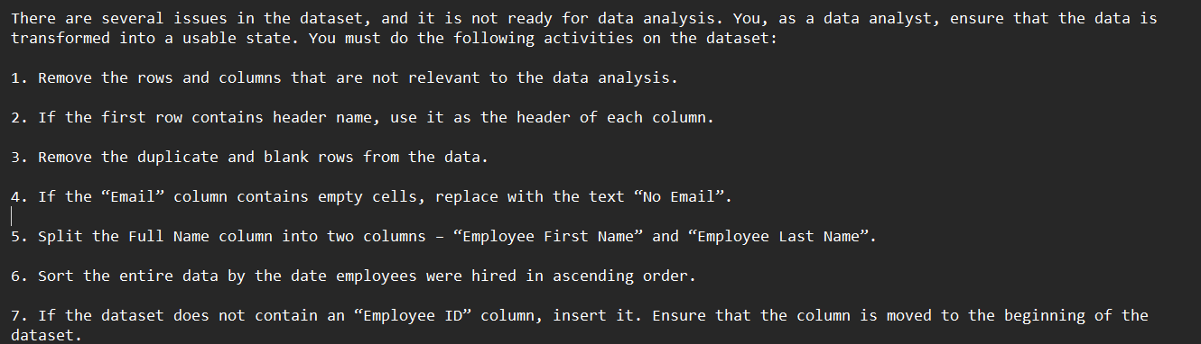
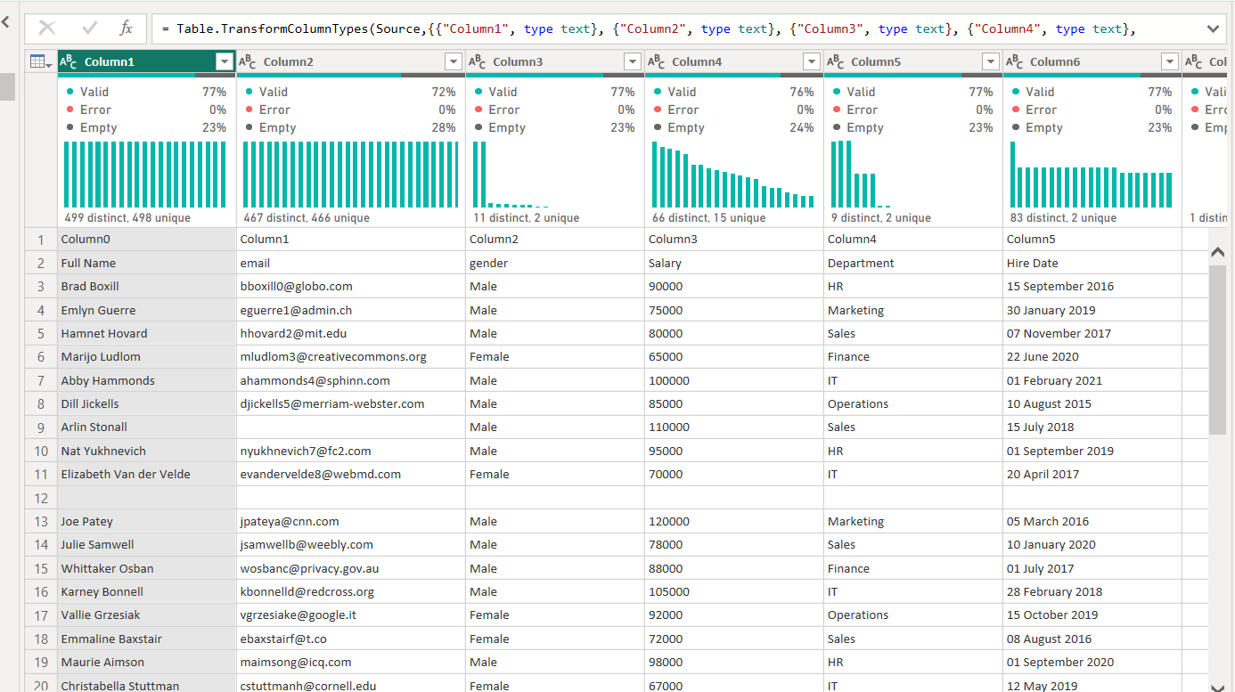
CASE STUDY 1
THE EMPLOYEE RECORDS
The goal was clear: establish a proper directory, isolate names, handle missing values, and generate unique corporate IDs.
Cleaning criteria defined upfront
Raw data: generic column names, blanks, duplicates

Slide 3
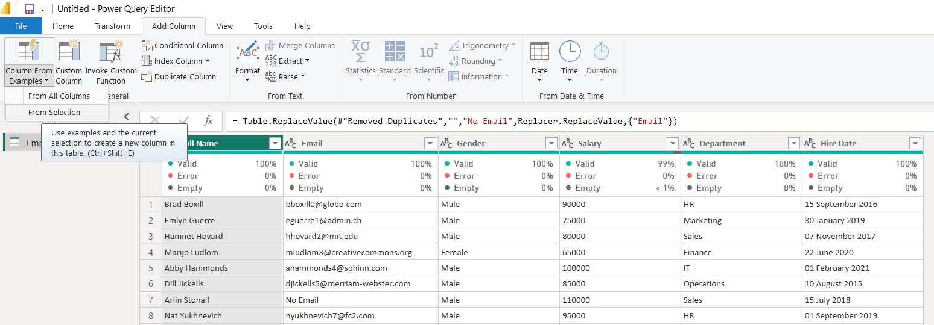
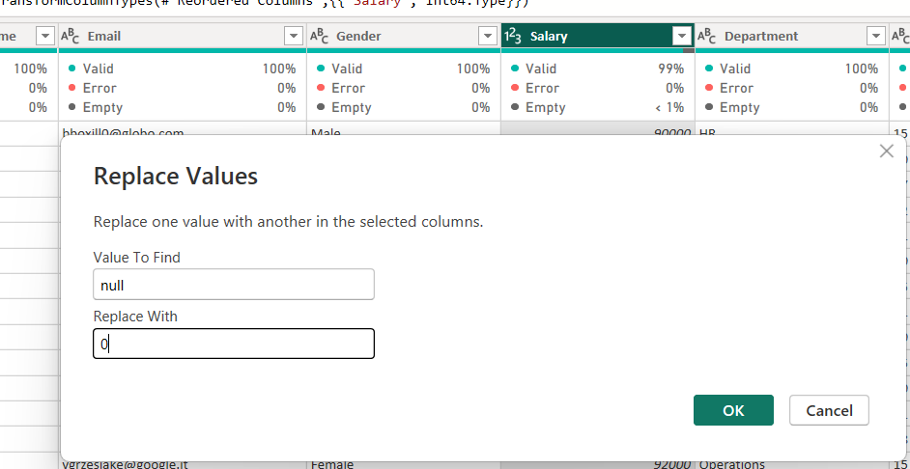
CASE STUDY 1
CLEANING THE STRUCTURE
Promoted headers, removed duplicates, and filtered out blank rows.
Replaced null salaries with 0 and empty emails with “No Email.”
1
Splitting the name into two parts
2
v
Replacing null salary values with 0

Slide 4
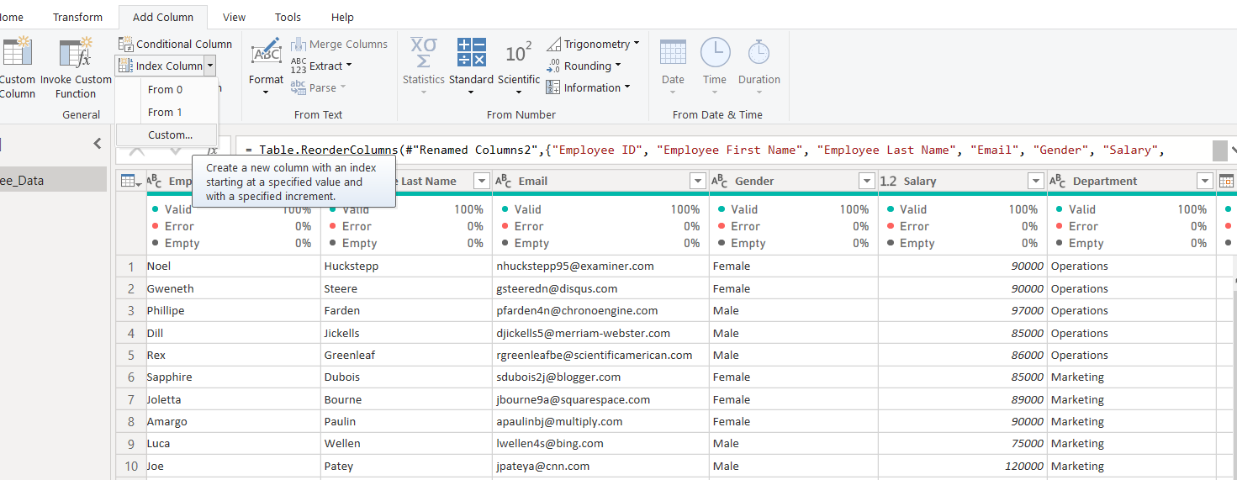
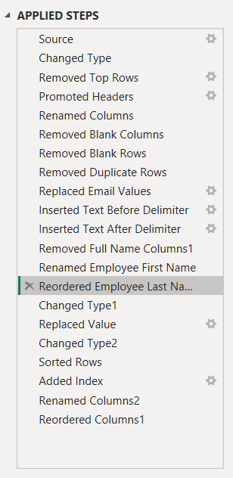

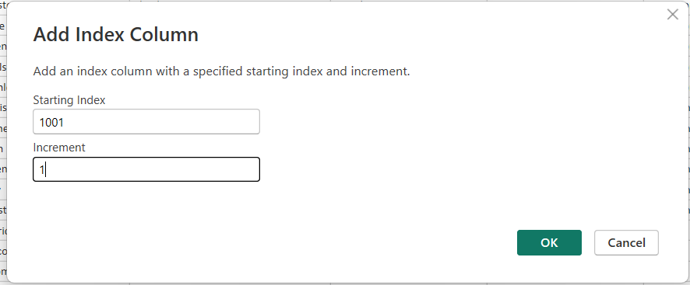
CASE STUDY 1
BUILDING UNIQUE RECORDS
Split full names into distinct First and Last Name columns.
Generated an auto-incrementing Employee ID starting from 1001.
1
Adding a custom index column
2
Starting the index at 1001

Slide 5
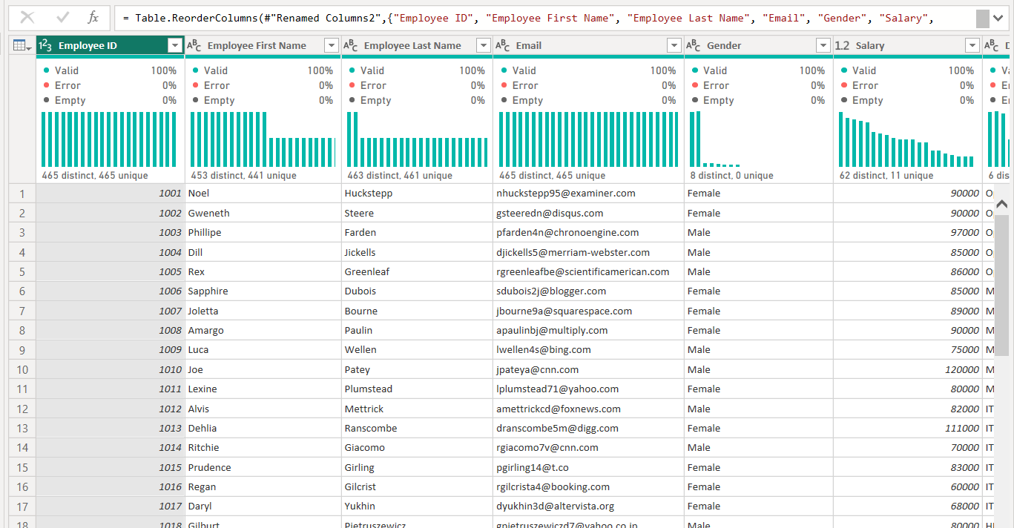
CASE STUDY 1
THE CLEANED DIRECTORY
Pristine, perfectly typed, sorted by hire date, and structurally ready for HR analytics.
465
0
1001+
UNIQUE RECORDS
MISSING VALUES
AUTO IDS ASSIGNED

Slide 6
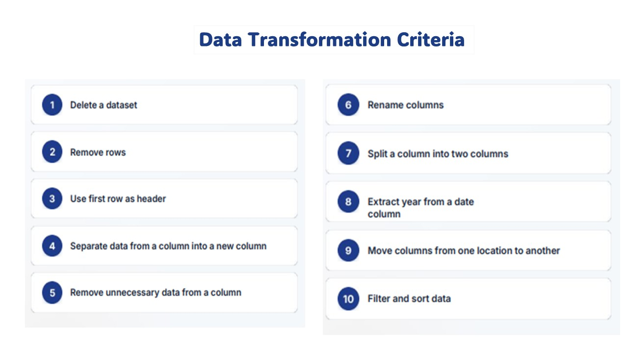
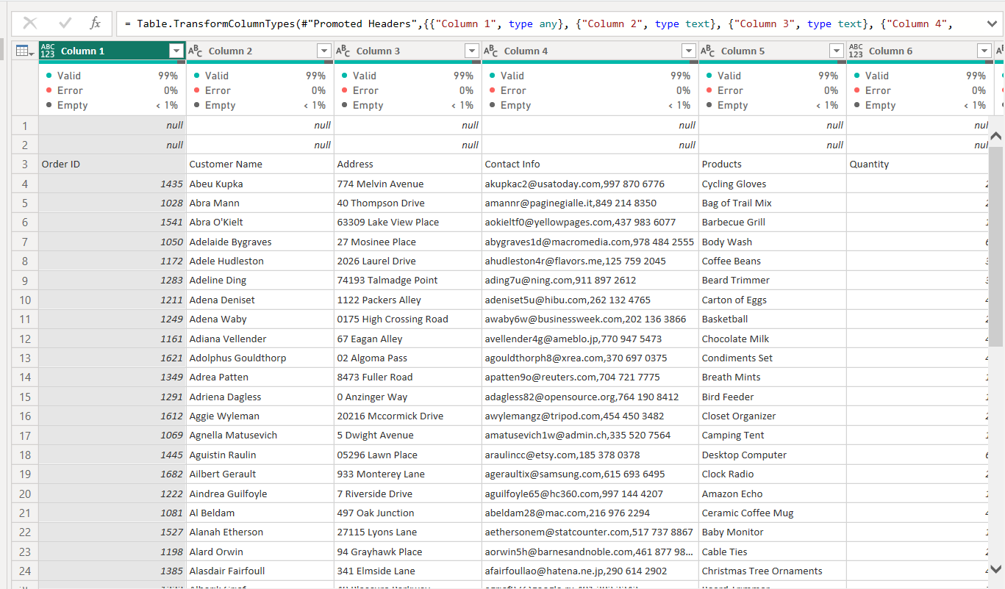
CASE STUDY 2
THE TRANSACTION LOG
E-commerce data is notoriously messy. This dataset contained blank structural rows, combined contact details, and currency symbols trapped inside text fields.
Transformation criteria defined upfront
Raw sales log nested values, null layers, blank rows

Slide 7
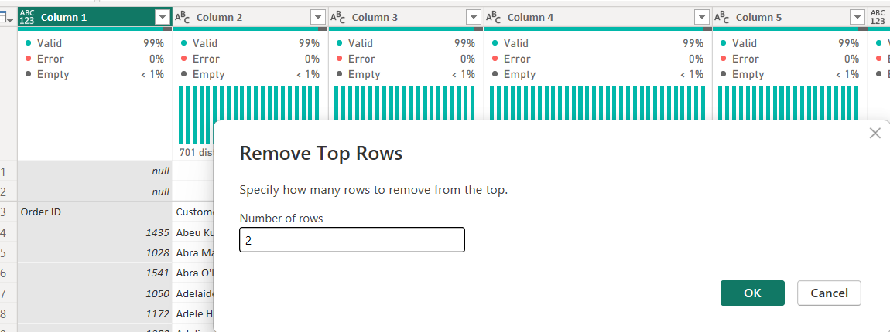
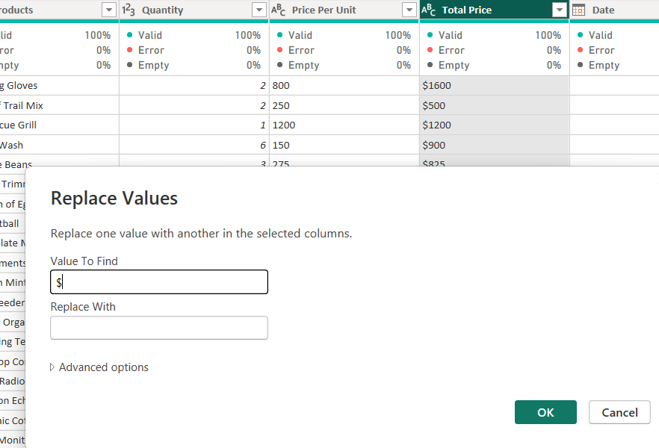
CASE STUDY 2
FIXING THE TYPE CORRUPTIONS
Removed irrelevant top rows and leftover structural blanks.
Stripped currency symbols to convert prices into true numbers.
Removing irrelevant top rows
Replacing “$” to unlock numeric prices

Slide 8
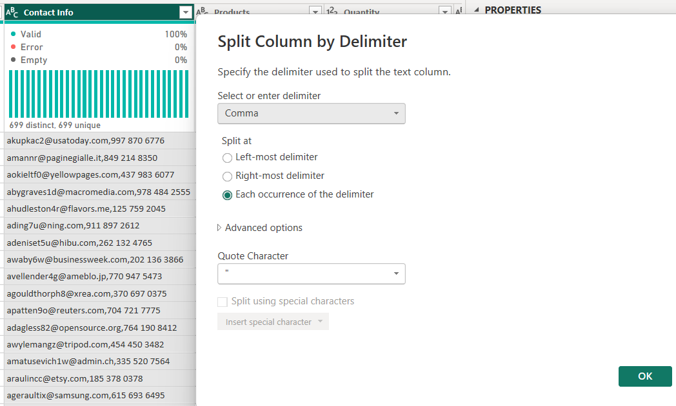
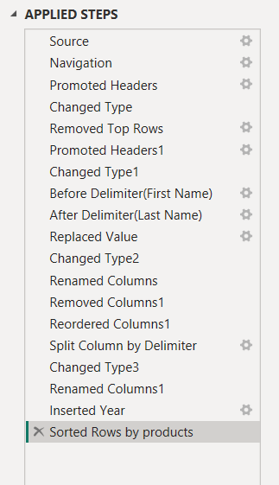
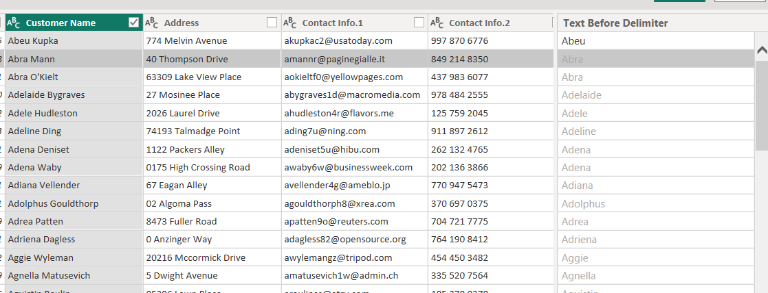
CASE STUDY 2
UNTANGLING CUSTOMER DATA
Parsed nested contact fields into isolated email and phone streams.
Split full customer names into First and Last Name columns.
Splitting contact info by delimiter
Extracting first names from full names

Slide 9
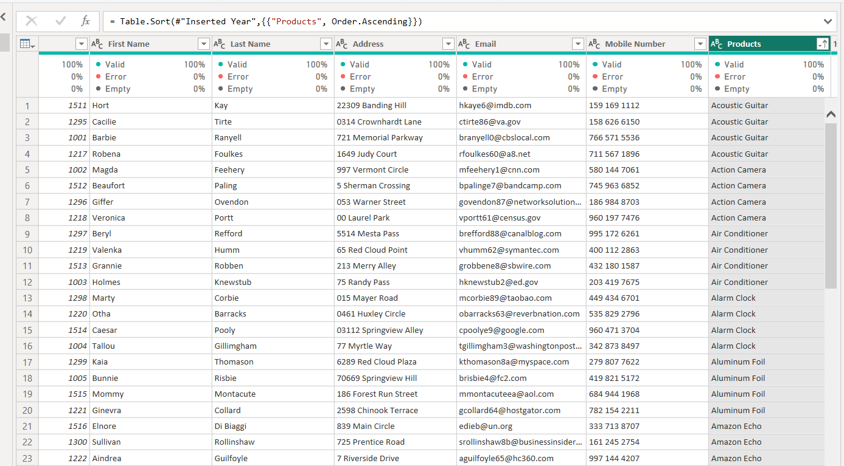
CASE STUDY 2
THE FINISHED SALES LEDGER
Numeric pricing, isolated contact fields, and a fully sorted product catalogue, ready for revenue analysis.
699
$0
2
CLEAN RECORDS
TEXT-LOCKED FREE PRICES
CONTACT FIELDS SPLIT

Slide 10



THE FOUNDATION
THE UNSEEN HERO OF DATA
Bad data leads to bad business decisions.
Before building stunning dashboards, an analyst must ensure the data is accurate, structured, and reliable.
Here is how I tackled two real-world scenarios to make raw data decision-ready.
RAW DATA
CLEAN DATA
Inconsistent, incomplete, unstructured
Accurate, structured, decision-ready

